Slide 1
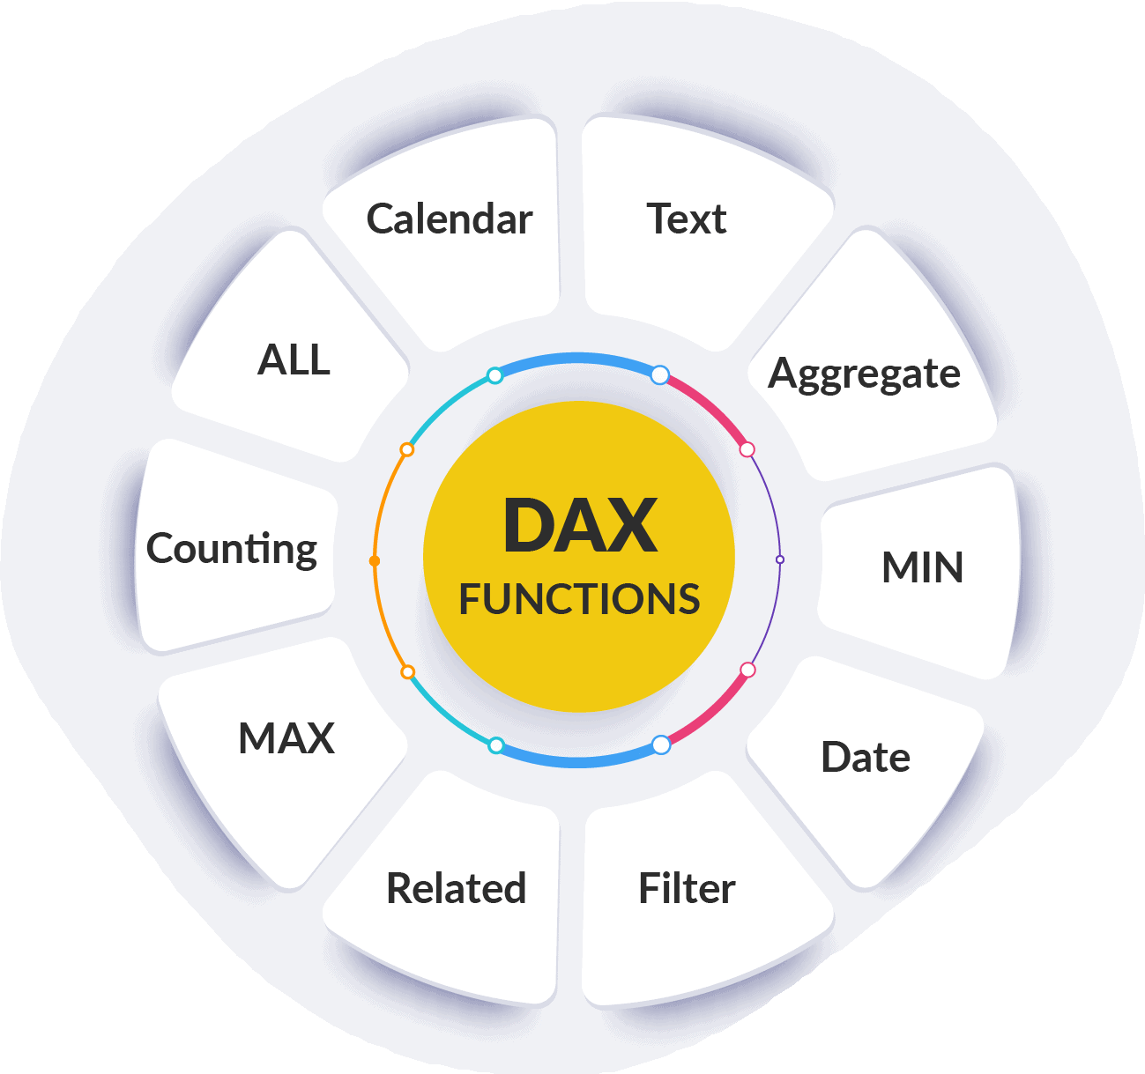
DAX(Data Analysis Expressions) Formulas in Power BI

Slide 2

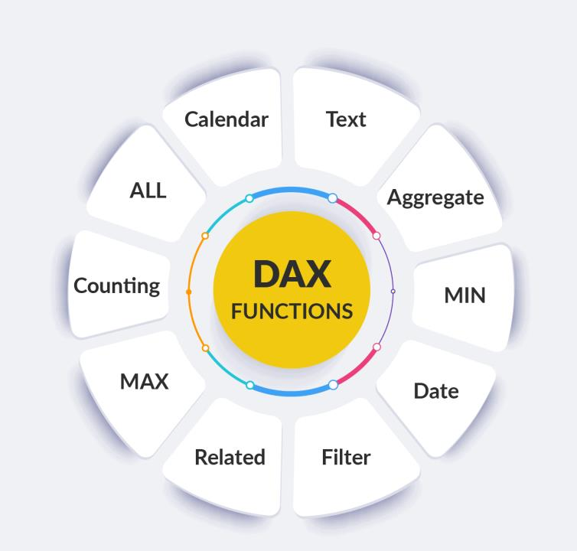
SUM FORMULA

Slide 3

SUM Formula in Power BI
Definition: SUM is a simple aggregation function that adds up all the values in a single column.
Example
Total_Sales = SUM(SalesData[Sales])
Use Case: Use SUM when you want to sum up all the values in a numeric column without any complex row-by-row operations.
Performance: Since it operates directly on a column, it's fast and efficient for simple summations.

Slide 4
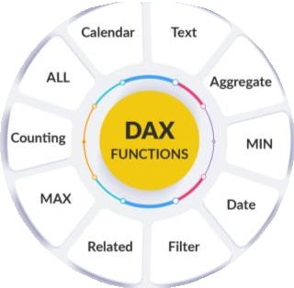
Calculated Column in Power BI
Definition: A calculated column is a new column that you create in a table using DAX (Data Analysis Expressions). The value for each row is calculated when the column is created, and it remains static unless the data is refreshed.
Example
Tax = SalesData[Sales]*18/100
Use Cases: Suitable for scenarios where you need a value for each row in the table, such as adding a new field derived from existing data (e.g., creating a "Total Price" column by multiplying "Quantity" and "Price").
Performance: Since calculated columns are stored in the model, they can affect performance, especially if the model is large.

Slide 5
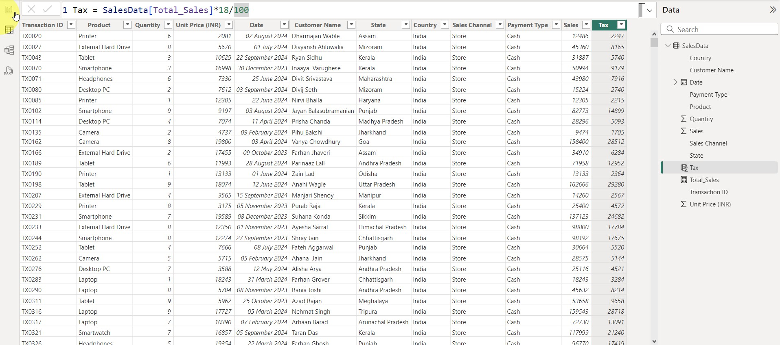
Calculated Column in Power BI

Slide 6
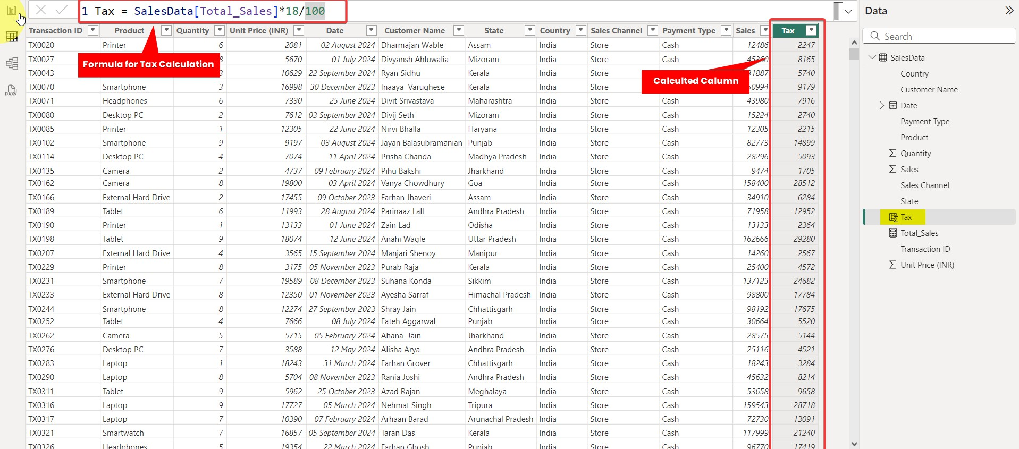

Calculated Column in Power BI

Slide 7
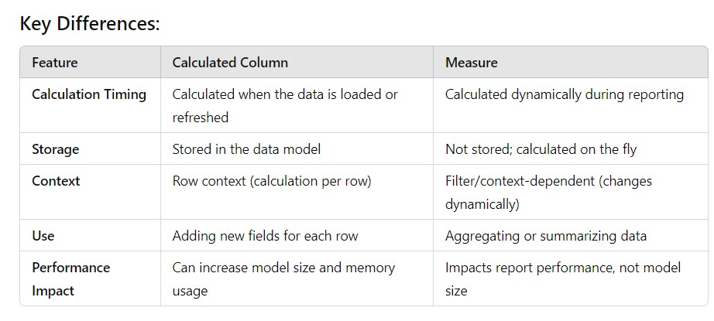
DIFFERENCE BETWEEN CALCULATED COLUMN AND MEASURE IN POWER BI
In Power BI, both calculated columns and measures are used to perform calculations, but they serve different purposes and behave differently. Here's a comparison of the two:

Slide 8
SUMX FORMULA

Slide 9
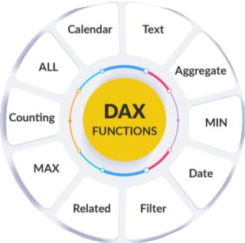
SUMX Formula in Power BI
Definition: SUMX is an iterator function that performs row-by-row calculations and then sums the results.
Example
Total_Sales2 = SUMX(SalesData,SalesData[Quantity]*SalesData[Unit Price (INR)])
Use Case: Use SUMX when you need to perform a calculation for each row before summing, such as multiplying two columns together or applying conditional logic.
Performance: SUMX can be slower than SUM because it performs calculations on each row individually before summing. It's ideal for more complex scenarios that require row context.

Slide 10
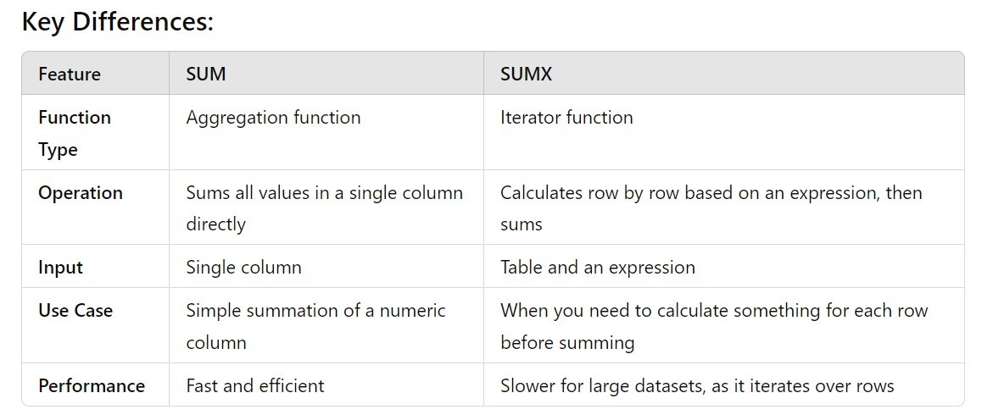
Difference between SUM and SUMX Formula in Power BI
In Power BI, both SUM and SUMX are used to perform summation, but they work differently
and are used in different scenarios. Here's a breakdown of the key differences:

Slide 11
COUNT FORMULA

Slide 12

Count Formula in Power BI
Definition: COUNT counts the number of non-blank values in a column.
Example
Number of Customers = COUNT('Table'[Customer ID])
Use Case: When you want to count the non-empty values in a column.

Slide 13
COUNTA FORMULA

Slide 14
COUNTA Formula in Power BI
Definition: COUNTA counts the number of non-blank values in a column, including text, numeric values, and logical values even counts Boolean values where only Count will not count Boolean data type
Example
Number of Reviews = COUNTA('Table'[Review Status])
Use Case: When you need to count all non-blank values, regardless of the
data type (text, numbers, etc.).

Slide 15
COUNTBLANK FORMULA

Slide 16
COUNTBLANK Formula in Power BI
Definition: COUNTBLANK counts the number of blank (empty) values in a column.
Example
Blank Reveiws = COUNTBLANK('Table'[Review Points])
Use Case: When you want to count the number of blank or missing values
in a column.

Slide 17
COUNTROWS FORMULA

Slide 18
COUNTROWS Formula in Power BI
Definition: COUNTROWS counts the number of rows in a table.
Example
Total Records = COUNTROWS('Table')
Use Case: When you want to count the total number of rows in a table or in
a filtered table.

Slide 19
DISTINCTCOUNT FORMULA

Slide 20
DISTINCTCOUNT Formula
Definition: DISTINCTCOUNT counts the number of unique, non-blank values in a column.
Example
Unique States = DISTINCTCOUNT('Table'[State])
Use Case: When you need to count the distinct (unique) values in a
column, excluding blanks.

Slide 21
COUNTX FORMULA

Slide 22
COUNTX Formula
Definition: COUNTX is an iterator function that counts non-blank results of an expression evaluated row by row over a table.
Example
Count Reviews >= 5 = COUNTX('Table', IF('Table'[Review Points] >= 5, 1, BLANK()))
Use Case: When you need to count based on an expression that is
evaluated for each row in a table.

Slide 23
COUNTAX FORMULA

Slide 24
COUNTAX Formula
Definition: COUNTAX is the iterator version of COUNTA. It evaluates an expression for each row and counts the number of non-blank results.
Example
Count True = COUNTAX(FILTER('Table','Table'[Review Status]=true),'Table'[Review Status])
Use Case: When you need to count based on an expression that is
evaluated for each row in a table even there is Binary data type.

Slide 25
COUNTROWS
with FILTER FORMULA

Slide 26
COUNTROWS with FILTER Formula
Definition: COUNTROWS can be used with the FILTER function to count rows that meet specific criteria.
Example
Maharashtra Count = COUNTROWS(FILTER('Table','Table'[State]="Maharashtra"))
Use Case: When you want to count rows based on a condition or set of
conditions.

Slide 27
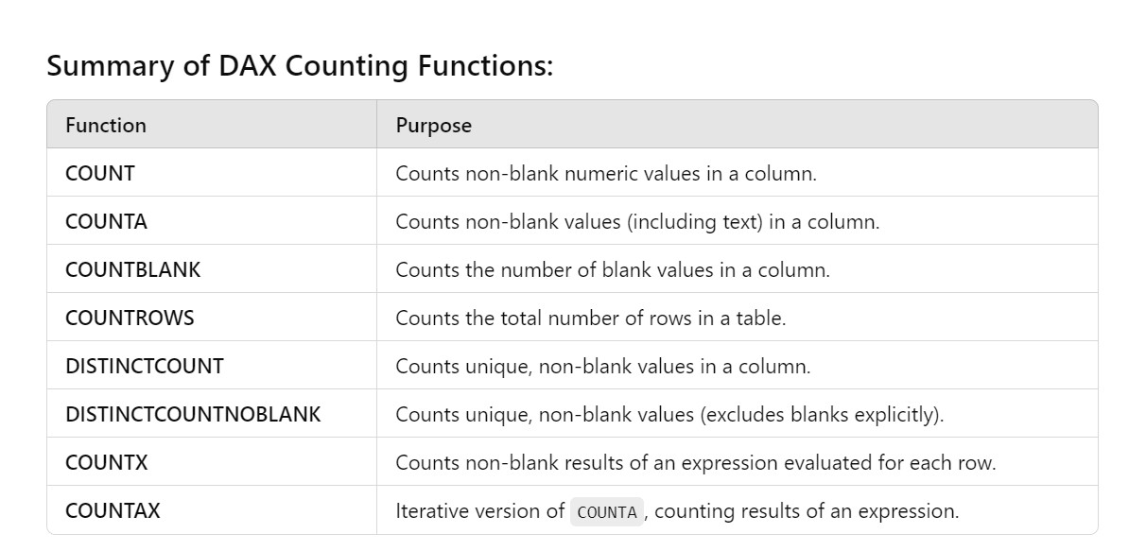
Summary of DAX Counting Functions:
These functions provide flexibility depending on whether you're counting all rows, distinct
values, non-blank values, or values based on expressions and conditions.

Slide 28
Date Formulas

Slide 29
Extract Day/Month/Year

Slide 30
Extract Day/Month/Year
DAY(<datetime>) : Extracts the day from a date value.
MONTH(<datetime>) : Extracts the month from a date value. YEAR(<datetime>) : Extracts the year from a date value.

Slide 31
Extract Hour/Minute/Second
Hour(<datetime>) : Extracts the Hour from a date and time value.
Minute(<datetime>) : Extracts the Minute from a date and time value. Second(<datetime>) : Extracts the Second from a date and time value.

Slide 32
Extract Hour/Minute/Second
Today() : Show Current date
Now() – Show current date and Time
Weekday() – Show Weekday in numbers between 1 to 7 Weeknum() – Show Week number in Month/Year

Slide 33
DatedIFF Formula
Definition: Returns the difference between two dates in the specified interval (days, months, years, etc.).
Syntax
DATEDIFF(<start_date>, <end_date>, <interval>)
Example
DATEDIFF(Sales[OrderDate], Sales[ShipDate], DAY)

Slide 34
Create Custom Calendar

Slide 35

1 . Create Custom Calendar in Power Query
Formula
= List.Dates(#date(2023,1,1),731,#duration(1,0,0,0))
Creating a custom calendar using Power Query in Power BI is a common and essential task when dealing with date-related data, especially for performing time-based analysis like year-over-year (YoY), month-to-date (MTD), and quarter-to-date (QTD) comparisons. Having a custom date table ensures that you have control over the format, date ranges, and any specific time-based logic needed for your reports.

Slide 36
2. Create Custom Calendar in Power Query
M Code
let
// Define start and end dates for the calendar
StartDate = #date(2020, 1, 1), // You can change this to your desired start date
EndDate = Date.From(DateTime.LocalNow()), // Automatically takes today's date as the end date
// Generate a list of dates between the start and end dates
DateList = List.Dates(StartDate, Duration.Days(EndDate - StartDate) + 1, #duration(1, 0, 0, 0)),
// Convert the list into a table
DateTable = Table.FromList(DateList, Splitter.SplitByNothing(), {"Date"}, null, ExtraValues.Error),
// Add Year, Month, and Day columns for further analysis
AddYear = Table.AddColumn(DateTable, "Year", each Date.Year([Date]), Int64.Type), AddMonth = Table.AddColumn(AddYear, "Month", each Date.Month([Date]), Int64.Type), AddDay = Table.AddColumn(AddMonth, "Day", each Date.Day([Date]), Int64.Type),
AddMonthName = Table.AddColumn(AddDay, "Month Name", each Date.ToText([Date], "MMMM"), type text),
AddQuarter = Table.AddColumn(AddMonthName, "Quarter", each Date.QuarterOfYear([Date]), Int64.Type),
AddYearMonth = Table.AddColumn(AddQuarter, "Year-Month", each Date.ToText([Date], "yyyy-MM"), type text),
AddWeekOfYear = Table.AddColumn(AddYearMonth, "Week of Year", each Date.WeekOfYear([Date]), Int64.Type),
AddDayOfWeek = Table.AddColumn(AddWeekOfYear, "Day of Week", each Date.ToText([Date], "dddd"), type text),
AddIsWeekend = Table.AddColumn(AddDayOfWeek, "Is Weekend", each if Date.DayOfWeek([Date],
Day.Sunday) > 4 then "Yes" else "No", type text)
in
AddIsWeekend

Slide 37
3 . Calendar DAX Formula
Formula
= CALENDAR(MIN(SalesData[Date]),MAX(SalesData[Date]))
The CALENDAR DAX function in Power BI is used to generate a continuous range of dates between a specified start and end date. It's particularly useful when building a date table, which is essential for time-based calculations such as year-over-year analysis, month-to-date, quarter-to- date, etc.

Slide 38
4 . CalendarAuto DAX Formula
Formula
= CALENDARAUTO()
The CALENDARAUTO function in Power BI is a powerful tool for creating a date table that automatically detects the date range from all date columns in your data model. This means it scans your data and generates a date range based on the minimum and maximum dates found in the model, which is especially helpful for dynamic date tables without specifying start or end dates manually.

Slide 39
MTD QTD AND YTD DAX FORMULA
Formula
Sales | MTD | = | TOTALMTD(SUM(Sales[SalesAmount]), | DateTable[Date])
Sales | QTD | = | TOTALQTD(SUM(Sales[SalesAmount]), | DateTable[Date])
Sales | YTD | = | TOTALYTD(SUM(Sales[SalesAmount]), | DateTable[Date])
MTD (Month-to-Date), QTD (Quarter-to-Date), and YTD (Year-to-Date) are commonly used DAX functions in Power BI for performing time-based aggregations. They are particularly helpful for tracking progress over the current month, quarter, or year, making it easy to see cumulative totals up to the present date. These functions rely on having a properly structured date table, ideally linked to your data model.

Slide 40
Networkdays DAX Formula
Formula
Network Days = NETWORKDAYS("01-01-2023","31-01-2023",1,Holidays)
In Power BI, Network Days refers to the count of working days (typically Monday through Friday) between two specified dates, excluding weekends and optionally excluding holidays.

Slide 41
Networkdays DAX Formula
Network Days = NETWORKDAYS("01-01-2023","31-01-2023",1,Holidays)
1 or omitted: Saturday, Sunday 2: Sunday, Monday
3: Monday, Tuesday
4: Tuesday, Wednesday
5: Wednesday, Thursday
6: Thursday, Friday
7: Friday, Saturday
11: Sunday only
12: Monday only
13: Tuesday only
14: Wednesday only
15: Thursday only
16: Friday only
17: Saturday only

Slide 42
DATESINPERIOD DAX FORMULA
Formula
DATESINPERIOD(<dates>, <start_date>, <number_of_intervals>, <interval>)
The DATESINPERIOD function in DAX returns a single-column table of dates within a specified period, based on a start date and a defined interval. It’s useful when you need to create calculations over dynamic date ranges (e.g., last 7 days, previous month, etc.).

Slide 43
Terrm | Meanining
Data Point | X axis yaxis
X axis yaxis
Figure | Canvas
Axes | Graph Box
Plot
Marker
Line style
Color
Legend
Label
Title
Grid
Function
Method
Parameters1
Key arguments
Object oriented api
DPI dot per inch
Backend

Slide 44
name
Grid()
Xlabel
Ylabel()
Plot()
Title()
Legend()
Xlim()
Ylim()
Show()
Xtickes()
Yticks()

Slide 45
DATESBETWEEN DAX FORMULA
Formula
DATESBETWEEN(<dates>, <start_date>, <end_date>)
The DATESBETWEEN function in DAX returns a table with dates within a specified start and end date range. This function is useful when you want to filter data to specific date boundaries.

Slide 46
SAME PERIOD LAST YEAR DAX FORMULA
Formula
SAMEPERIODLASTYEAR(<dates>)
The SAMEPERIODLASTYEAR function in DAX is used to return a table with the dates for the same period in the previous year. This function is often used in time intelligence calculations to compare current performance to the previous year.

Slide 47
CALCULATE DAX FORMULA
Formula
SAMEPERIODLASTYEAR(<dates>)
The SAMEPERIODLASTYEAR function in DAX is used to return a table with the dates for the same period in the previous year. This function is often used in time intelligence calculations to compare current performance to the previous year.

Slide 48

TEXT FORMULAS
In Power BI, there are several DAX functions designed for working with text data. These functions allow you to manipulate and format text values in various ways. Here are some commonly used text DAX formulas in Power BI:
LEFT, RIGHT, MID
LEFT("Power BI", 5) // Result: "Power" RIGHT("Power BI", 2) // Result: "BI" MID("Power BI", 7, 2) // Result: "BI"

Slide 49
TEXT FORMULAS
In Power BI, there are several DAX functions designed for working with text data. These functions allow you to manipulate and format text values in various ways. Here are some commonly used text DAX formulas in Power BI:
UPPER and LOWER
UPPER("Power BI") // Result: "POWER BI" LOWER("Power BI") // Result: "power bi"
LEN: Returns the length (number of characters) of a text string.

